Slide 1
The Inheritance Mechanism
  Means of deriving new class from existing classes, called base classes
  Reuses existing code eliminating tedious, error prone task of developing new code
  Derived class developed from base by adding or altering code

Slide 2
Types of Inheritance
Single Inheritance: It is the inheritance hierarchy wherein one derived class inherits from one base class.
• Multiple Inheritance: It is the inheritance hierarchy wherein one derived class inherits from multiple base class(es)
• Hierarchical Inheritance: It is the inheritance hierarchy wherein multiple subclasses inherit from one base class.
• Multilevel Inheritance: It is the inheritance hierarchy wherein subclass acts as a base class for other classes.
• Hybrid Inheritance: The inheritance hierarchy that reflects any legal combination of other four types of inheritance.

Slide 3
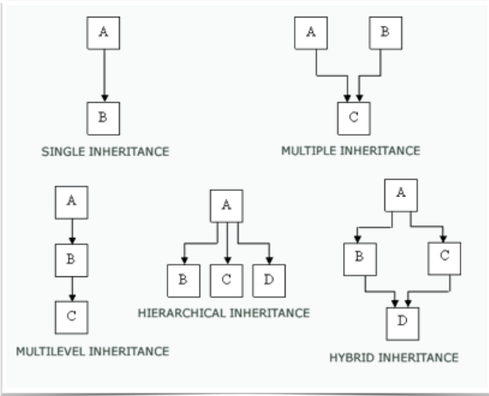
Types

Slide 4
Single and Multiple Inheritance
  Single inheritance occurs
  when single base class
  Multiple inheritance occurs
  when more than
  one base class

Slide 5
Credit Cards - Single Inheritance
  Same basic features
  Each is a little different

Slide 6
Voice Mail - Multiple Inheritance
  Voice mail has features
  of both mail and phone

Slide 7
A Derived Class
  Class derived from an existing class
class classname:(public|protected|private)_{opt} basename
{
member declarations
};
  class Keyword
  Keywords public, protected, and private used to specify how base class members are accessible to derived class 

Slide 8
Benefits of Inheritance
  Code is reused
    grad_student uses tested code from student
  Reflects relationship in problem domain
    Special grouping grad student outgrowth of real world and treatment of this group
  Polymorphic mechanisms allow client code to treat inherited class as subtype of base class
    Simplifies code, maintains subtype distinctions 

Slide 9
Public Inheritance (is a subtype)
  Publicly inherited remain public
  Private members can't be inherited
  Protected members remain protected 
student
shape
grad_student
ellipse
polygon

Slide 10
Access Specifier: public
The keyword public tells the compiler that base will be inherited such that:
  all public members of the base class will also be public members of derived.
However, all private elements of base will remain private to it and are not directly accessible by derived.

Slide 11
Example: Base Class
class base {
int x;
public:
void setx(int n) { x = n; }
void showx() {
cout << x << ‘\n’ }
};
// Inherit as public
class derived : public base {
int y;
public:
void sety(int n) { y = n; }
void showy() { cout << y << ‘\n’;}
};
int main() {
derived ob;
ob.setx(10);
ob.sety(20);
ob.showx();
ob.showy();
}

Slide 12
Access Specifier: private
If the access specifier is private:
  public members of base become private members of derived.
  these members are still accessible by member functions of derived.

Slide 13
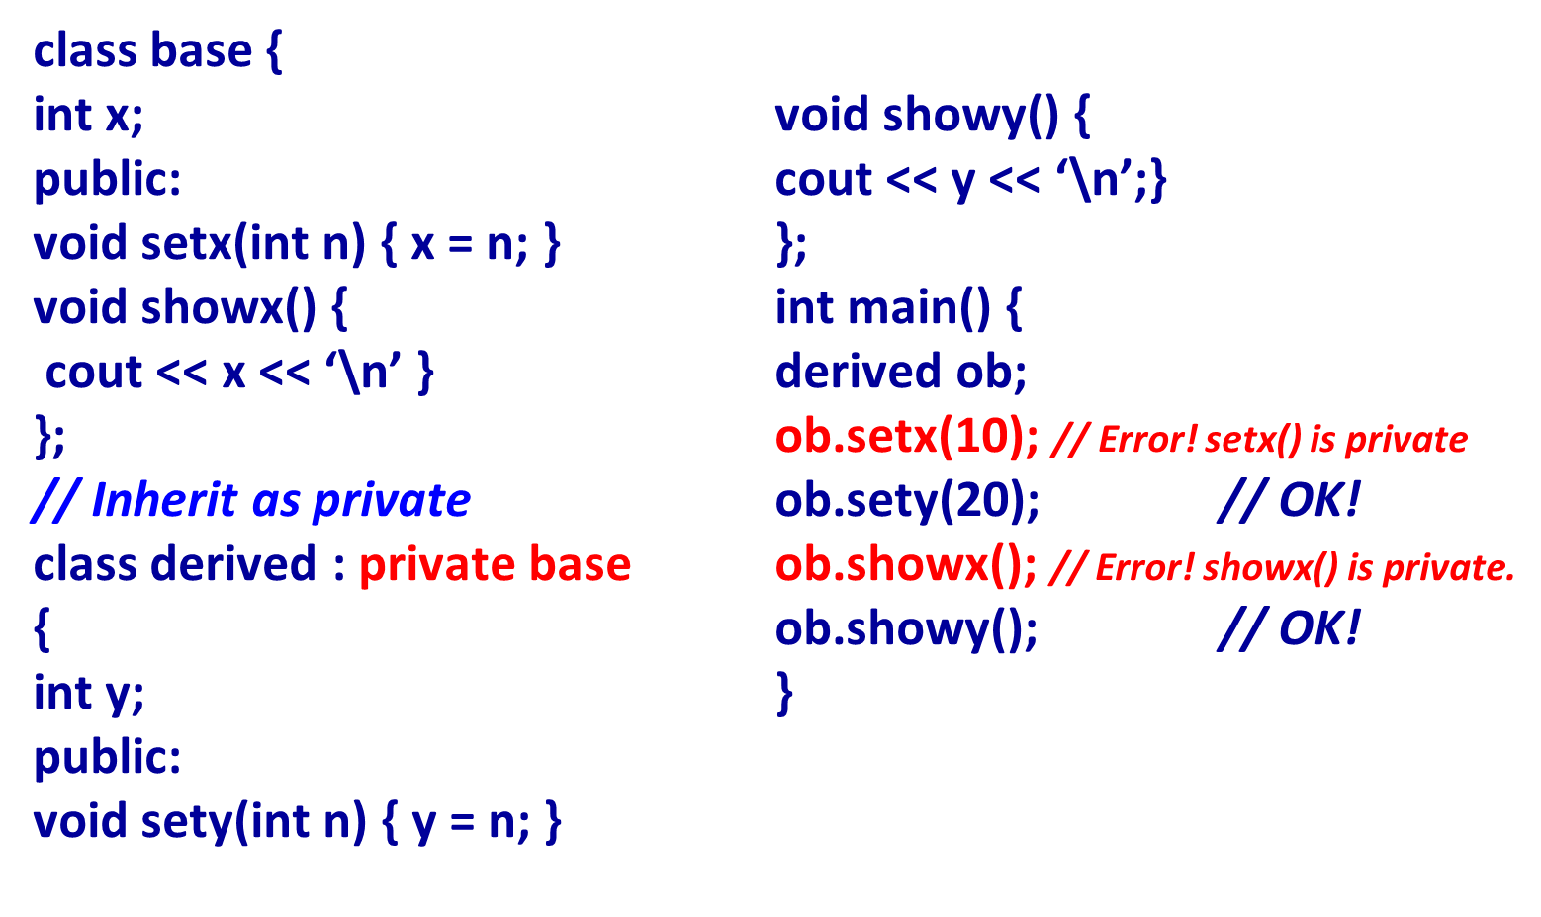
Example: Derived Class

Slide 14
Protected Members
Sometimes you want to do the following:
  keep a member of a base class private
  allow a derived class access to it
Use protected members!
If no derived class, protected members is the same as private members.

Slide 15
Protected Members
The full general form of a class declaration:
class class-name {
// private members
protected:
// protected members
public:
// public members
};

Slide 16
3 Types of Access Specifiers
Type 1: inherit as private
Base | Derived
private members | inaccessible
protected members | private members
public members | private members

Slide 17
3 Types of Access Specifiers
Type 2: inherit as protected
Base | Derived
private members | inaccessible
protected members | protected members
public members | protected members

Slide 18
3 Types of Access Specifiers
Type 3: inherit as public
Base | Derived
private members | inaccessible
protected members | protected members
public members | public members

Slide 19
Single Level Inheritance
// Base
class Shape {
protected:
int width,height;
public:
void setWidth(int w)
{ width = w; }
void setHeight(int h)
{ height = h; }
};
class Rectangle: public Shape {
public:
int getArea() {
return (width * height); }
};
int main(void) {
Rectangle Rect; Rect.setWidth(5); Rect.setHeight(7);
// Print the area of the object.
cout << "Total area: " << Rect.getArea() << endl;
return 0; }
Output:
Total area: 35

Slide 20
Multilevel Inheritance
class A
{ ... .. ... };
class B: public A
{ ... .. ... };
class C: public B
{ ... ... ... };
base 1
derived 1
derived 2

Slide 21
Multilevel Inheritance
class person {
protected :
string name,gender;
int age;
public:
void getdata()
{ cout<<"Name: ";
cin>>name;
cout<<"Age: ";
cin>>age;
cout<<"Gender: ";
cin>>gender;
}
void display() {
cout<<"Name: "<<name<<endl; cout<<"Age: "<<age<<endl; cout<<"Gender: "<<gender<<endl;
}
};

Slide 22
Multilevel inheritance
class employee: public person
{stringcompany;
float salary;
public:
void getdata()
{
person::getdata();
cout<<"Name of Company: ";
cin>>company;
cout<<"Salary: Rs.";
cin>>salary;
}
void display() { person::display(); cout<<"Name of Company: "<<company<<endl; cout<<"Salary: Rs."<<salary<<endl; } };

Slide 23
Multilevel Inheritance
class programmer: public employee
{ int number;
public:
void getdata() {
employee::getdata();
cout<<"Number of programming language known: "; cin>>number;
}
void display() {
employee::display();
cout<<"No. of programming language known: "<<number;
} };

Slide 24
Multilevel Inheritance
int main() {
programmer p;
cout<<"Enter data"<<endl;
p.getdata();
cout<<endl<<"Displaying data"<<endl;
p.display();
}

Slide 25
Multiple Inheritance
base 1
base 2
derived

Slide 26
Multiple Inheritance
class student {
protected:
int rno, m1, m2;
public:
void get() {
cout << "Enter the Roll no :";
cin>>rno;
cout << "Enter the two marks :";
cin >> m1>>m2;
}
};
class sports {
protected:
int sm;
// sm = Sports mark
public:
void getsm() {
cout << “Enter the sports mark :"; cin>>sm;
}
};

Slide 27
Multiple Inheritance
class statement : public student, public sports {
int tot, avg;
public:
void display() {
tot = (m1 + m2 + sm);
avg = tot / 3;
cout << "\n\n\tRoll No : " << rno << "\n\tTotal : " << tot;
cout << "\n\tAverage : " << avg;
}
};
void main() {
statement obj;
obj.get();
obj.getsm();
obj.display();
}

Slide 28
Using Multiple Inheritance
tools
parts
labor
plans

Slide 29
Hierarchical Inheritance
class Shape
{ protected:
float width, height;
public:
void set_data (float a, float b)
{ width = a;
height = b; }
};
class Rectangle: public Shape
{ public:
float area ()
{ return (width * height); }
};
class Triangle: public Shape
{ public:
float area () {
return (width * height / 2); }
};
int main ()
{
Rectangle rect;
Triangle tri;
rect.set_data (5,3);
tri.set_data (2,5);
cout << rect.area() << endl;
cout << tri.area() << endl;
}
Output
15
5

Slide 30
Overriding Base Class Functions
• A derived class can override a member function of its base class by defining a derived class member function with the same name and parameter list.
• It is often useful for a derived class to define its own version of a member function inherited from its base class.
• This may be done to specialize the member function to the needs of the derived class. When this happens, the base class member function is said to be overridden by the derived class

Slide 31
Overriding member functions
class mother
{ public:
void display ()
{ cout << "mother: display function\n“; }
};
class daughter : public mother
{ public:
void display ()
{ cout << "daughter: display function\n\n“; }
};
int main ()
{ daughter rita;
rita.display();
}
Output :
daughter: display function

Slide 32
Gaining Access to an Overridden Function
class daughter : public mother
{
public:
void display ()
{
cout << "daughter: display function\n\n";
mother::display();
}
};
Outputs :
daughter: display function
mother: display function
To gain access to the base class function include the function call statement
baseClass::function(paraments) in the derived class.

Slide 33
Constructor and Inheritance
The compiler automatically calls a base class constructor before executing the derived class constructor. The compiler’s default action is to call the default constructor in the base class.
You can specify which of several base class constructors should be called during the creation of a derived class object.
This is done by specifying the arguments to the selected base class constructor in the definition of the derived class constructor.

Slide 34
Passing arguments
What if the constructor functions of both the base class and derived class take arguments?
Pass all necessary arguments to the derived class’s constructor.
Then pass the appropriate arguments along to the base class.

Slide 35
Example: Constructor of base
class base {
int i;
public:
base(int n) {
cout << “constructing base \n”;
i = n; }
~base() { cout << “destructing base \n”; }
};

Slide 36
Example: Constructor of derived
class derived : public base {
int j;
public:
derived (int n, int m) : base (m) {
cout << “constructing derived\n”;
j = n; }
~derived() { cout << “destructing derived\n”;}
};

Slide 37
Example: main()
int main() {
derived o(10,20);
return 0;
}
constructing base
constructing derived
destructing derived
destructing base

Slide 38
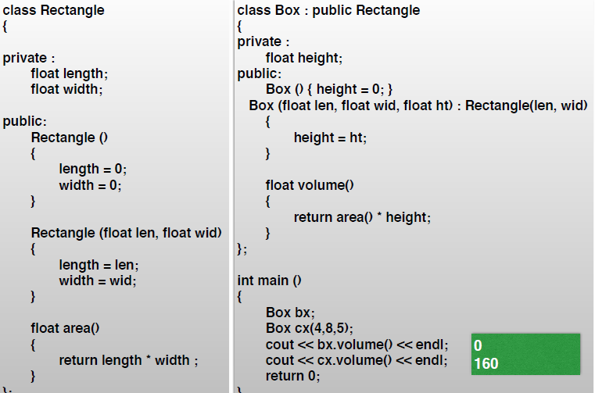
Example 2

Slide 39
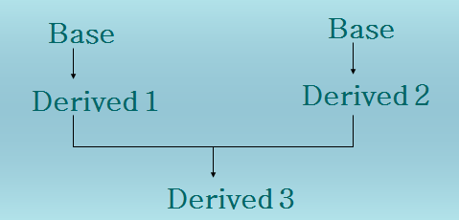
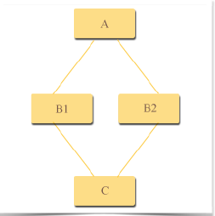
Virtual Base Class
Multi-path inheritance may lead to duplication of inherited members from a grandparent base class.

Slide 40
Virtual Inheritance
  Two base classes derived from common ancestor
  If both base classes used in ordinary way by derived class, that class will have two sub objects of common ancestor
  Duplication, if not desirable, eliminated by using virtual base class

Slide 41
Virtual Base Class
class base {
public:
int i;
};
// Inherit base as virtual
class D1 : virtual public base {
public:
int j;
};
class D2 : public virtual base {
public:
int k;
};
/* Here, D3 inherits both D1 and D2.
However, only one copy of base is present */
class D3 : public D1, public D2 {
public:
int product () {
return i * j * k; }
};

Slide 42
Example
base *p; // base class pointer
base B_obj;
derived D_obj;
p = &B_obj; // p can point to base object
p = &D_obj; // p can also point to derived // object

Slide 43
Pointers to Derived Classes
A pointer declared as a pointer to base class can also be used to point to any class derived from that base.
However, only those members of the derived object that were inherited from the base can be accessed.

Slide 44
Virtual Member Functions
  Functions declared in base class and redefined in derived class
  Class hierarchy defined by public inheritance creates related set of user types, all of whose objects may be pointed at by a base class pointer
  By accessing virtual function through this pointer, C++ selects appropriate function definition at run-time 

Slide 45
Virtual Function
A virtual function is a member function
  declared within a base class
  redefined by a derived class (i.e. overriding)
It can be used to support run-time polymorphism.

Slide 46
Example
class base {
public:
int i;
base (int x) { i = x; }
virtual void func() {cout << i; }
};

Slide 47
Example
class derived : public base {
public:
derived (int x) : base (x) {}
// The keyword virtual is not needed.
void func() {cout << i * i; }
};

Slide 48
Example
int main() {
base ob(10), *p;
derived d_ob(10);
p = &ob;
p->func(); // use base’s func()
p = &d_ob;
p->func(); // use derived’s func()
}

Slide 49
Pure Virtual Functions
A pure virtual function has no definition relative to the base class.
Only the function’s prototype is included.
General form:
virtual type func-name(paremeter-list) = 0

Slide 50
Example: area
class area {
public:
double dim1, dim2;
area(double x, double y)
{dim1 = x; dim2 = y;}
// pure virtual function
virtual double getarea() = 0;
};

Slide 51
Example: rectangle
class rectangle : public area {
public:
// function overriding
double getarea() {
return dim1 * dim2;
}
};

Slide 52
Example: triangle
class triangle : public area {
public:
// function overriding
double getarea() {
return 0.5 * dim1 * dim2;
}
};

Slide 53
Dynamic Virtual Function Selection
  Typically base has virtual function and derived have their versions of function
  Pointer to base class can point at either base or derived class objects
  Member function selected depends on class of object being pointed at, not on pointer type
  In absence of derived type member, base class virtual function used by default 

Slide 54
Restrictions on virtual Functions
  Only non-static member functions virtual
  Virtual characteristic is inherited
    Derived class function automatically virtual virtual keyword not needed
  Constructors cannot be virtual
  Destructors can be virtual 

Slide 55
Using virtual (1 of 2)
class shape {
public:
virtual double area() const {return (0);} protected:
double x, y;
};
class rectangle: public shape {
public:
double area() const {return (height * width);}
private:
double height, width;
};

Slide 56
Using virtual (2 of 2)
class circle: public shape {
public:
double area() const
{ return (PI * radius * radius); }
private:
double radius;
};

Slide 57
Comments on the shapes Program
  Virtual function allow run-time decisions
  Different shapes derived from shape base class
  Derived classes correspond to important, well understood types of shapes
  Added to by deriving further classes
  Area calculation is a local responsibility 

Slide 58
Classes and Virtual Functions
  Root class of hierarchy usually contains number of virtual functions to provide dynamic typing
  Pure virtual function provides dummy functions as placeholders in base class which had specific functions in derived classes 

Slide 59
Pure Virtual Functions
  Pure virtual function has body
virtual function prototype = 0;
  Pure virtual function used to defer implementation decision of the function
  In OOP terminology - deferred method 
62

Slide 60
Abstract Base Classes
  Class with at least 1pure virtual function
  Useful to have root class for type hierarchy as abstract class
  Basic common properties of derived classes but cannot itself declare objects
  Declare pointers that access subtype objects derived from abstract class 
63

Slide 61
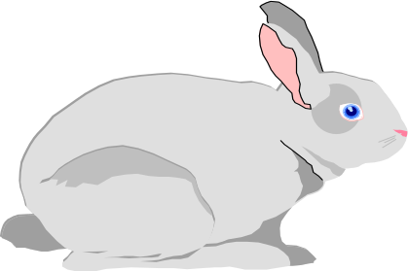
Using Abstract Base Classes (1 of 2)
  Primitive form of ecological simulation in which world has different forms of life interacting
  Abstract base class is living
    Interface inherited by various forms of life
  Fox as archetypal predator and rabbit as its prey
  Rabbit eats grass 

Slide 62
Using Abstract Base Classes (2 of 2)

